Slide 1
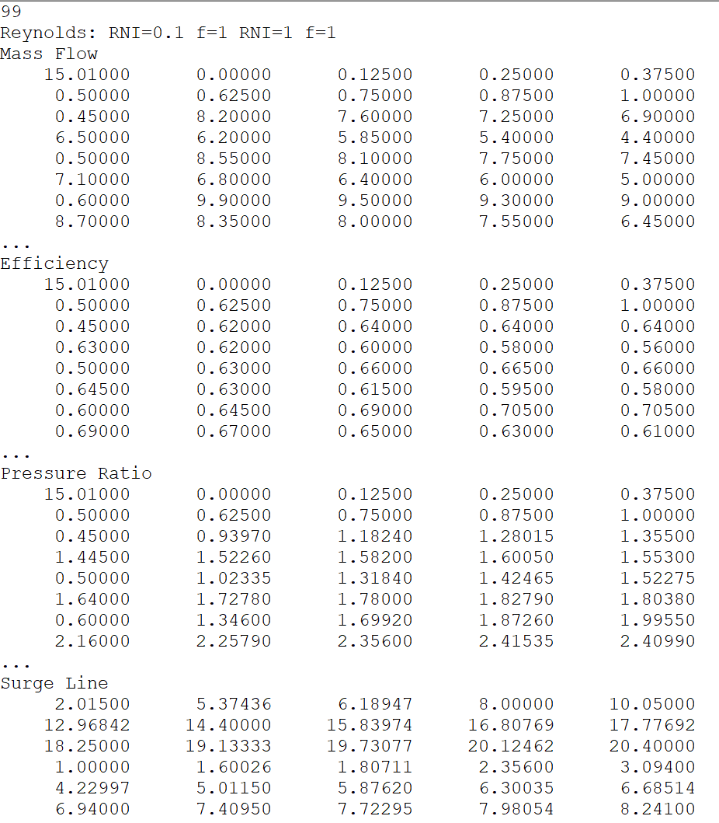
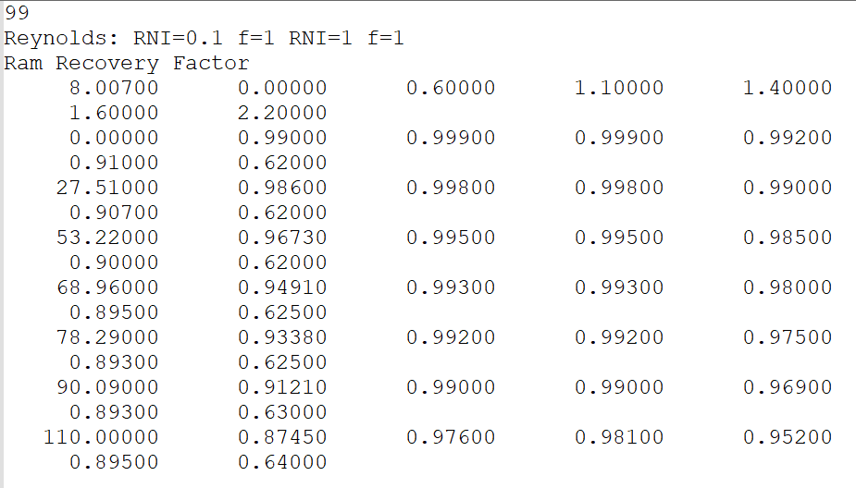
Implementation of component performance maps
Component model implementations
Tabulated relations of parameters
Applicable to various model components
Compressor map
Inlet ram recovery map

Slide 2
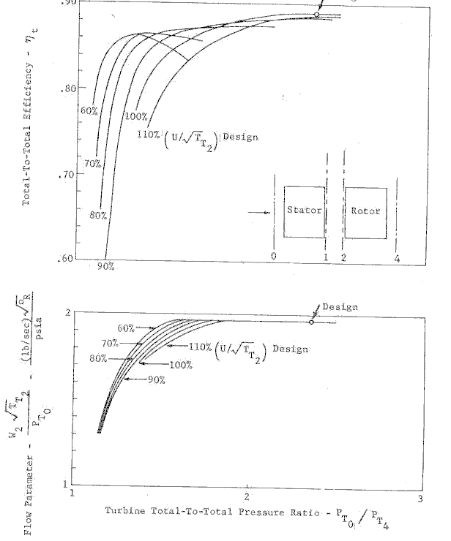
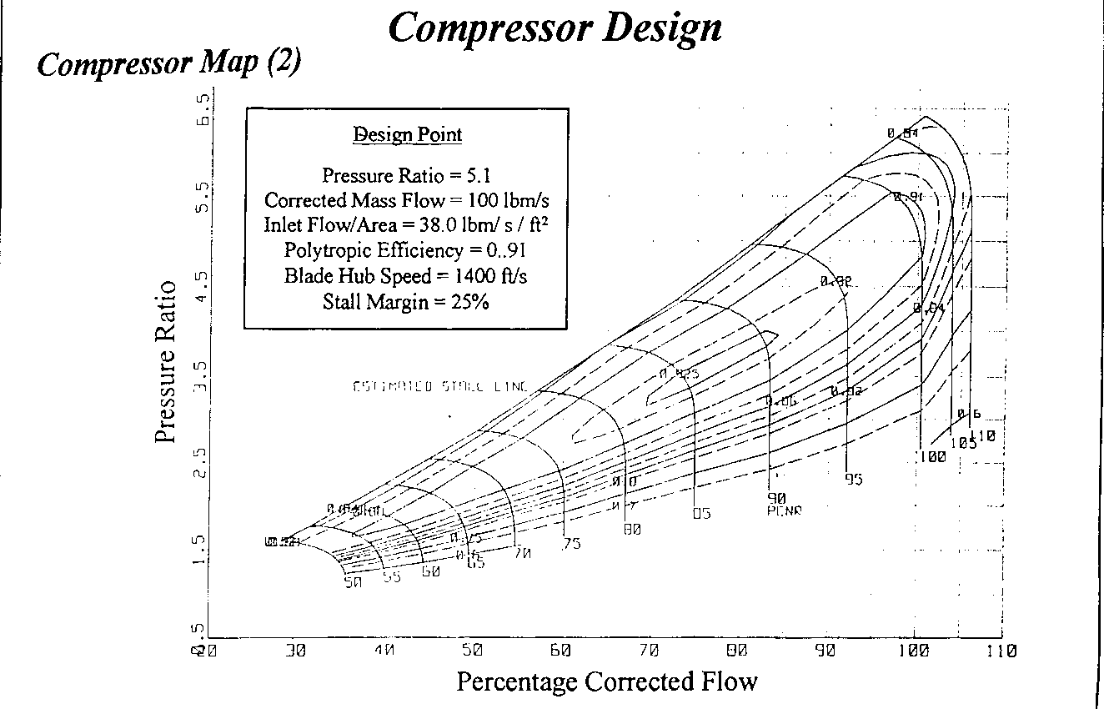
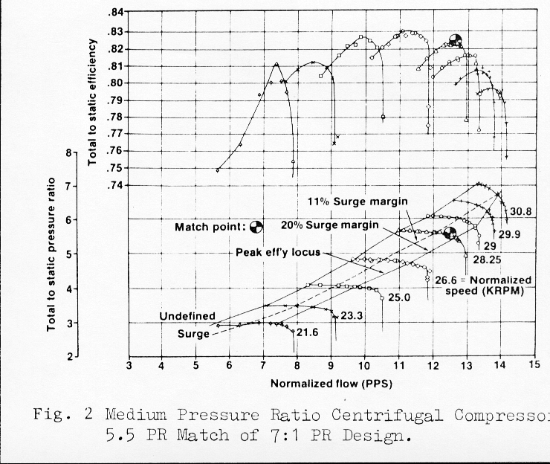
Turbomachinery map characteristics
Component model implementations
Several formats available
Known format used in GSP and Gasturb
Relations between
Pressure, corr. mass flow, efficiency and spool speed
Introducing an alternative axis Beta (β)
For stable iteration
Ensures a single solution
Compressor maps
Turbine map

Slide 3
Turbomachinery map characteristics
Component model implementations
Reading & Plotting maps allows for Object Orientation
legend
Generic map class TMap
plotmap(), readmap(), etc.
data
functions, procedures (algorithms)
Abstract class
Instantiable class
Turbo map class TTurboMap
ReadNcBetaCrossTable(), etc.
TCompressorMap
ReadSurgeCrossTable(), etc.
TTurbineMap
ReadPRlimits(), etc.

Slide 4
Turbomachinery map characteristics
Component model implementations
Consider the following data when plotting
Pressure ratio, Mass flow, Spool speed
Efficiency contours
Limits
Surge line for compressor
Min./max. pressure for turbine
Design point (cycle reference point)
Off design operating line (transient or steady state)
Map scaling
Use standard plot libraries! matplotlib

Slide 5
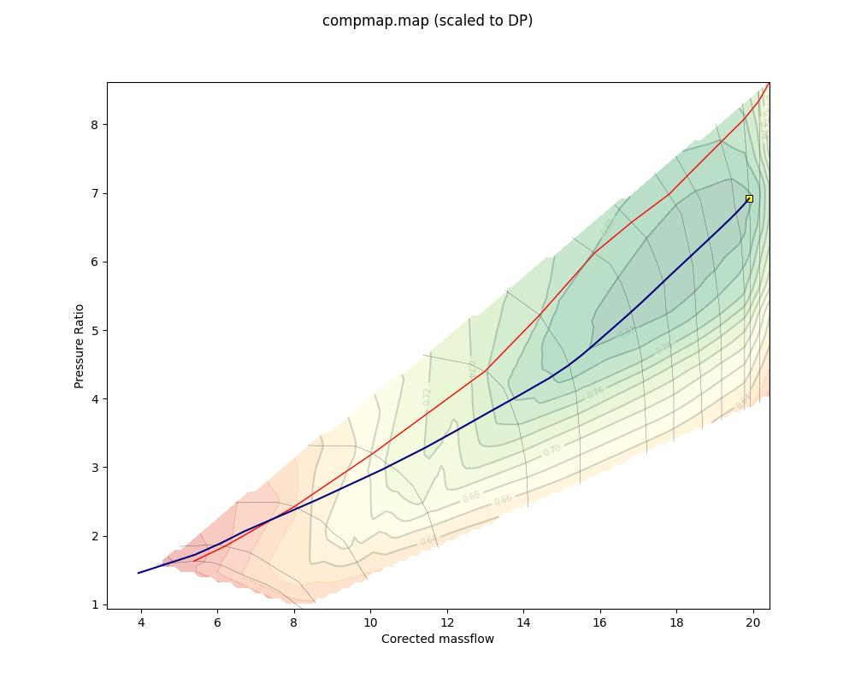
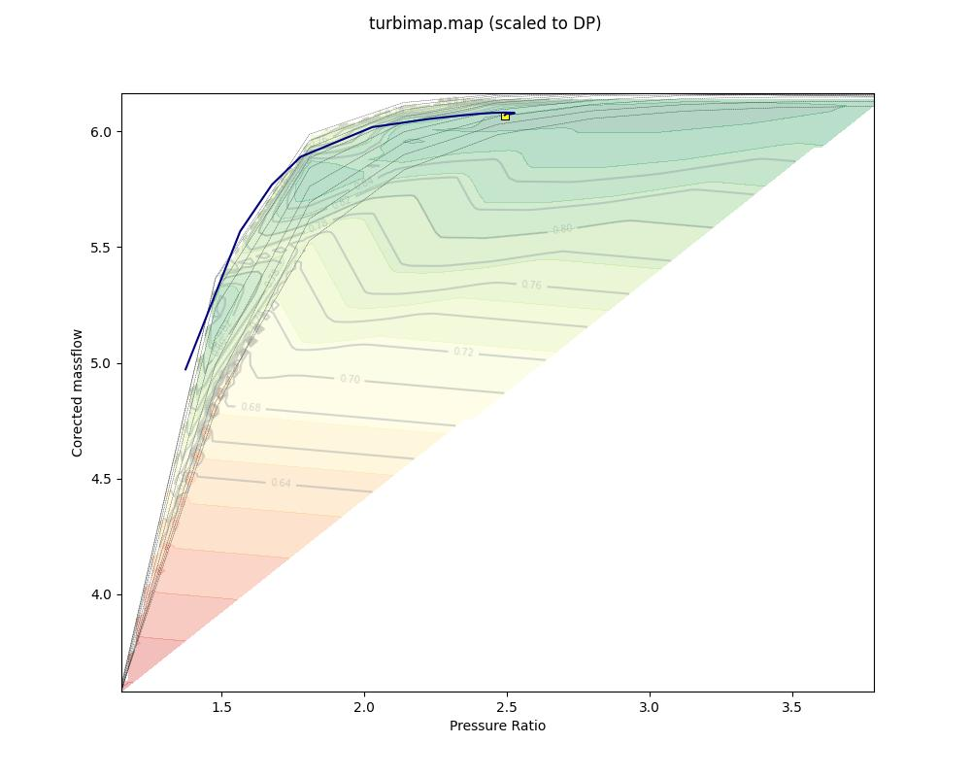
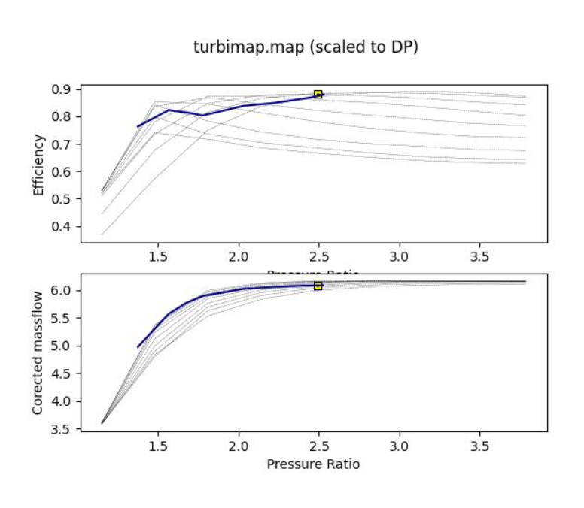
Turbomachinery map characteristics
Component model implementations
Few lines of code!
Compressor map
Turbine maps

